Slide 1


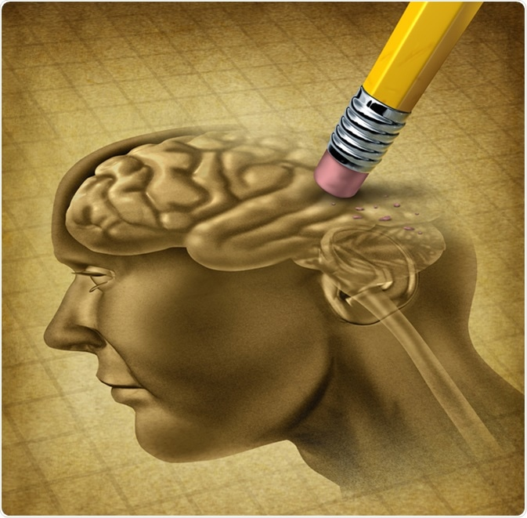

Alzheimer Detection Using MRI Dataset

Slide 2
Supervisors :
Dr. Mohamed Hassan Abd El Aziz
T.A: Osama Fawzy
Team members :
Bassam Mohamed Kamal Hassan
Ahmed Mohamed Abualftouh Salem
Ahmed Mabrouk Fekry Abd Elfttah
Ahmed Magdy Ahmed Ali
Kamal Salah Kamal Abo Elkhier

Slide 3
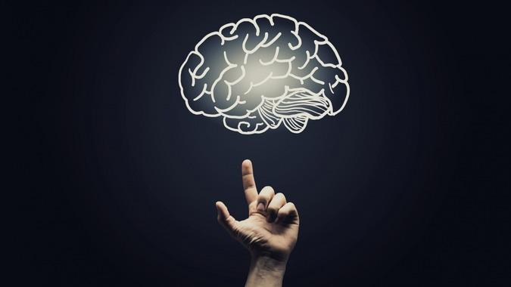
Agenda
Introduction
Problem definition
Motivation
Objectives
Dataset
System Architecture
SVM Model
CNN Models
Demo
Future Work
Time Plan

Slide 4
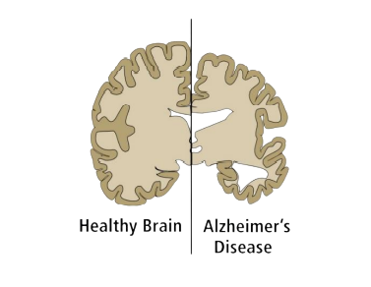
Introduction
Alzheimer's disease is one of the most common types of dementia. Symptoms appear gradually and end with severe brain damage as a result of nerve cell death. persons with Alzheimer's disease loses the abilities of knowledge, memory, language and learning.

Slide 5

Problem definition
Approximately 55 million people worldwide are affected by dementia, and the cost of providing health and social care for them is equivalent to the world’s 18th largest economy. Early and accurate diagnosis of AD plays an essential role in prevention, treatment, and patient care through tracking its development. The focus of several research projects is to detect Alzheimer’s disease using brain imaging, including MRI. It can measure the size and number of cells in the brain. Also, it can show the parietal atrophy for AD cases.

Slide 6
Motivation
by 2050 The annual number of new cases of AD and other dementias is projected to triple, reaching 152 million cases, Accordingly, it is important to detect Alzheimer’s disease as early as possible .

Slide 7
Objectives
Develop a deep learning model for detecting four forms of Alzheimer's disease (Non-Demented, Moderate Demented, Mild Demented, Very Mild Demented).

Slide 8
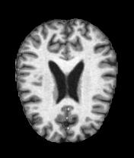
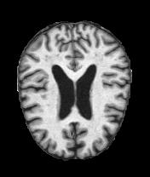
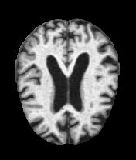
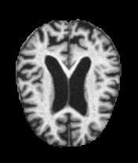
Dataset
The data consists of MRI images. The data has four classes of images both in training as well as a testing set:
Non-Demented
Very Mild Demented
Mild Demented
Moderate Demented

Slide 9
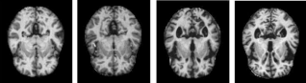
System Architecture
Feature Extraction+
Classifier(SVM)
Preprocessing
OR
Classification Result
Convolutional Neural Network

Slide 10
Comments on Survey
Most common datasets: MRI Images With 4 classes or 3 classes
Most preprocessing Techniques: Data augmentation, Resizing
Best accuracy:
 | Classifier | Dealing with four classes
Traditional model | SVM | 76%~81%
Deep learning model | CNN | 91% ~95%

Slide 11
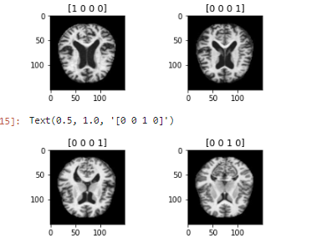
Preprocessing
Label Encoding
Resize the images
Normalization
Data after preprocessing:

Slide 12
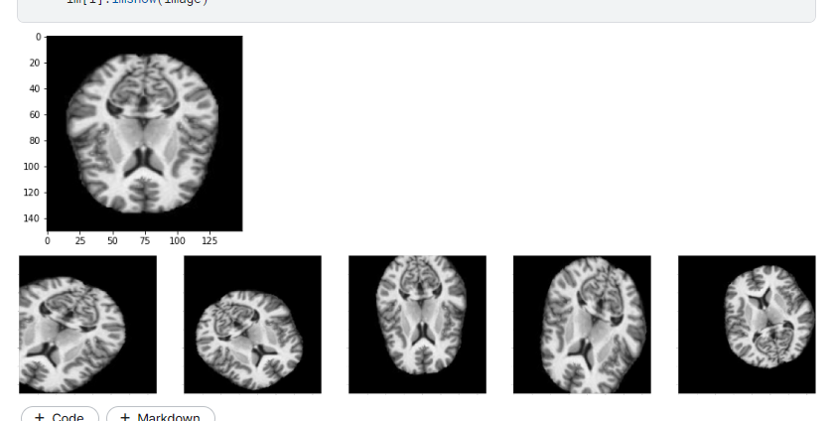
Preprocessing
Data Augmentation:
Rotation
Width and Height shifting
shearing
Zooming
Flipping

Slide 13
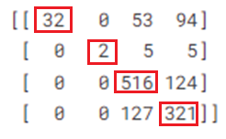
SVM Model
Feature Extraction:
We used HOG to extract the features from images
Model Parameters:
Kernel = RBF
Gamma = 0.001
C=1
Results: Test accuracy with SVM 68%
Confusion Matrix:

Slide 14
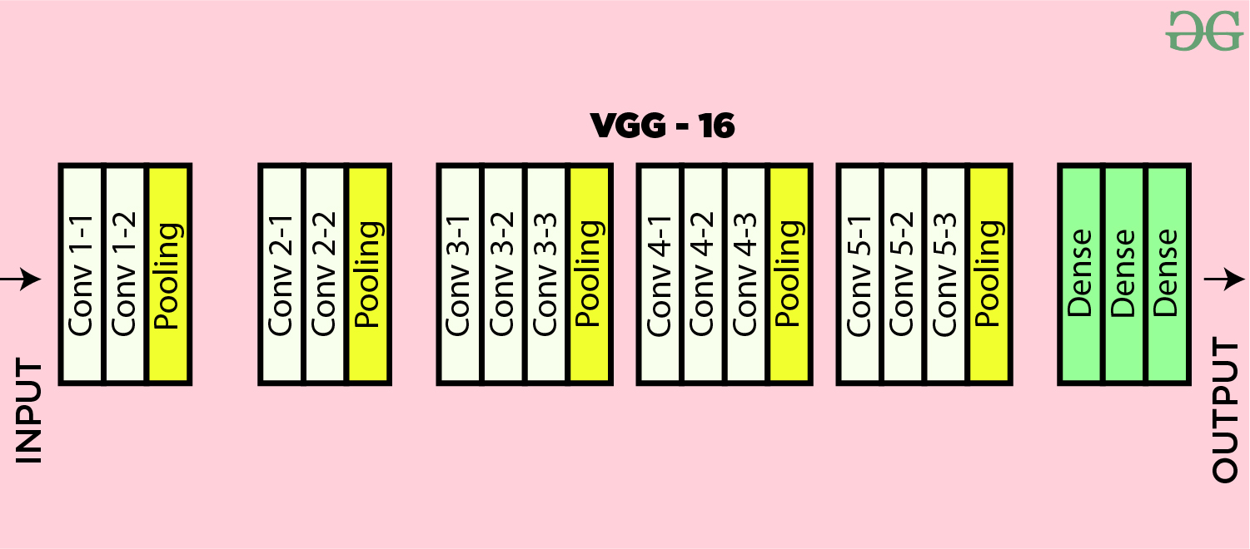
CNN Model
VGG16 architecture:
Optimizer = SGD Learning Rate = 0.0001
Loss Function = Categorical Cross-entropy Epochs = 20
Activation Function = Relu Activation Function (FC) = SoftMax

Slide 15
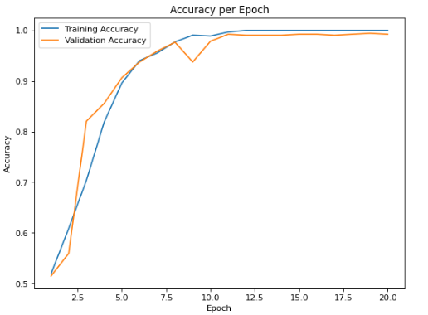
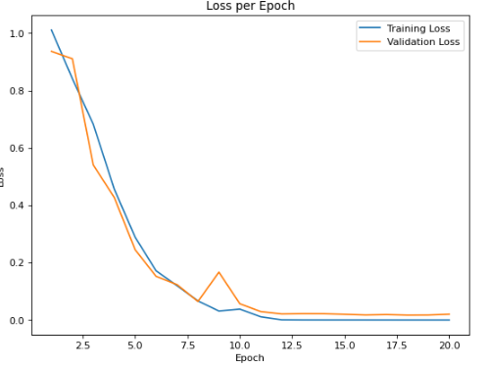
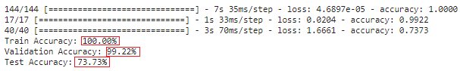
CNN Model
Results:

Slide 16
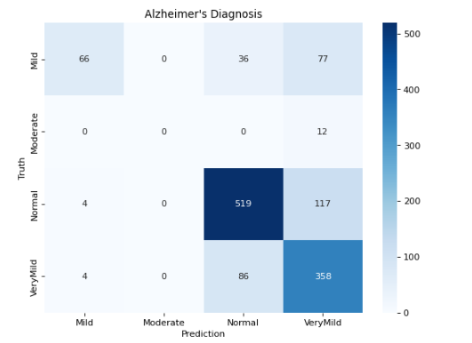
CNN Model
Results:
Confusion matrix:
Comment on Results:
From confusion matrix we noticed that all moderate class images classified as very mild, so the model didn’t train enough on moderate.
And noticed from accuracy 99% validation accuracy and test accuracy only 73% so there are features in test data the model didn’t train on it.
So, we tried to concatenate all data and split it again to train, validation and test in the begging and applied this technique in the next model.

Slide 17
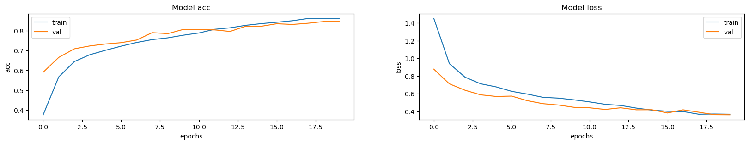
Result after concatenation
Testing Accuracy: 83.74%

Slide 18
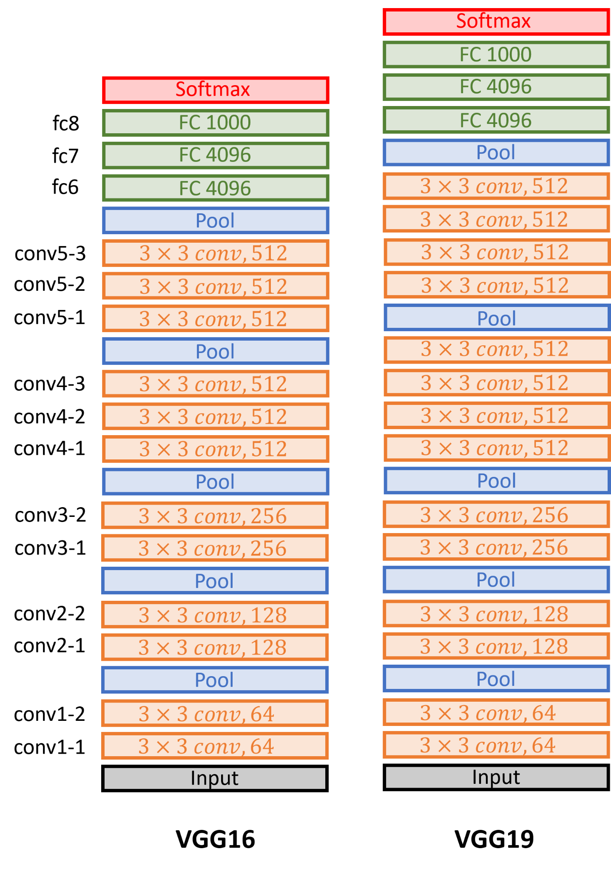
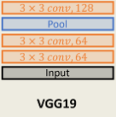
CNN Model
VGG19 Model:
Optimizer = SGD
Batch size=2
Learning Rate = 0.0001
Loss Function = Categorical Cross-entropy
Epochs = 20
Activation Function = Relu
Activation Function (FC) = SoftMax

Slide 19
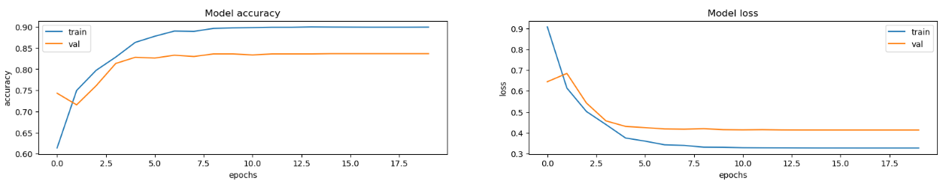
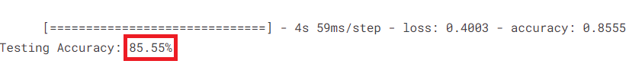
CNN Model
VGG19 Model:

Slide 20
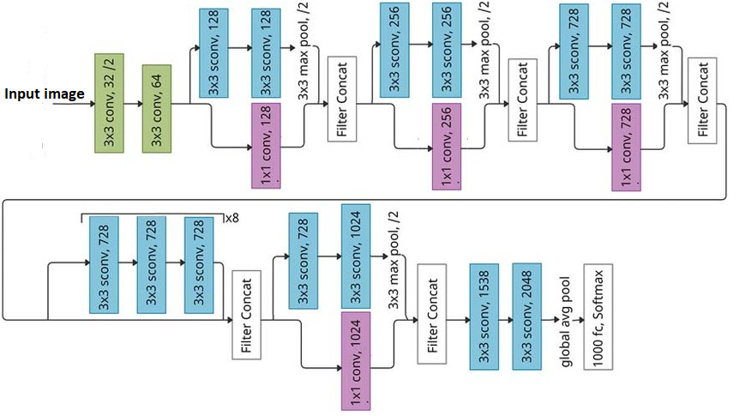
CNN Model
Xception model:
Optimizer = SGD Batch size=2
Learning Rate = 0.0001 Loss Function = Categorical Cross-entropy
Epochs = 20 Activation Function = Relu
Activation Function (FC) = SoftMax

Slide 21
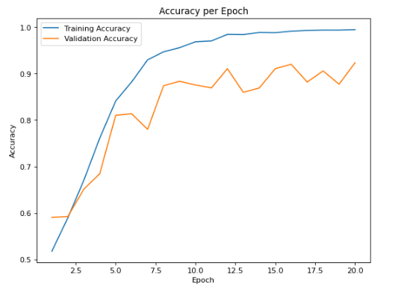
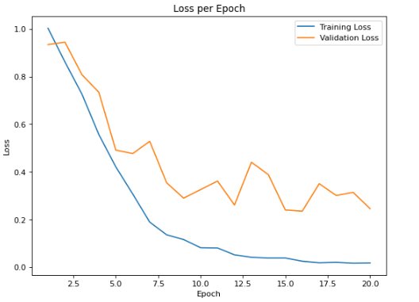
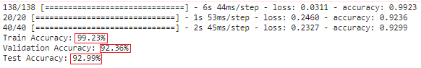
CNN Model
Results:

Slide 22
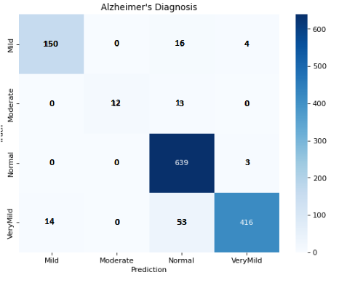
CNN Model
Results:
CONFUSION MATRIX:
This model is better with validation accuracy 92% and test accuracy is 93% but from the error curve, it can be enhanced .

Slide 23
CNN Model
After many trials and errors, we found that the Xception model was too complex for our dataset and the accuracy did not increase.
Therefore, we switched back to the VGG19 model and tuned different values of the hyperparameters, as well as changed the architecture of the fully connected layer and added Dropout layers.
We tried many models to obtain the best accuracy

Slide 24
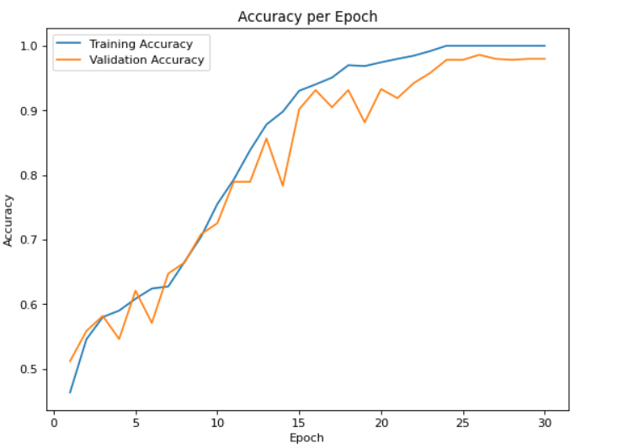
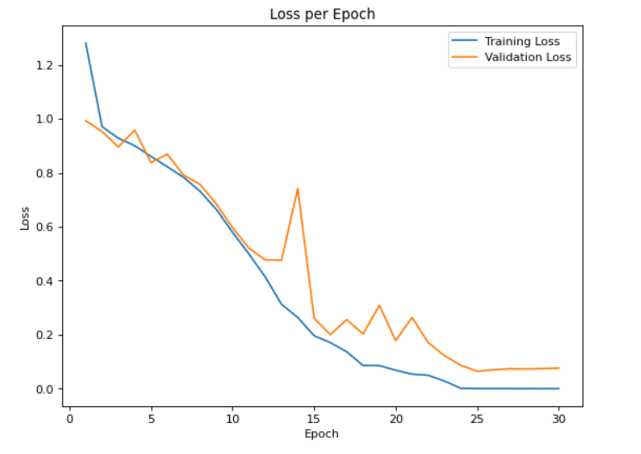
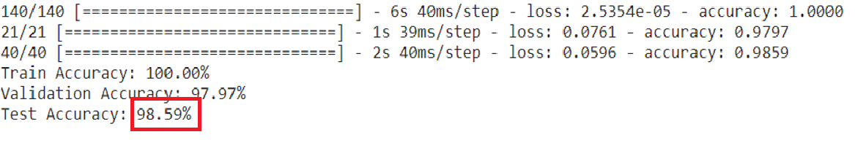
CNN Model
Results:

Slide 25
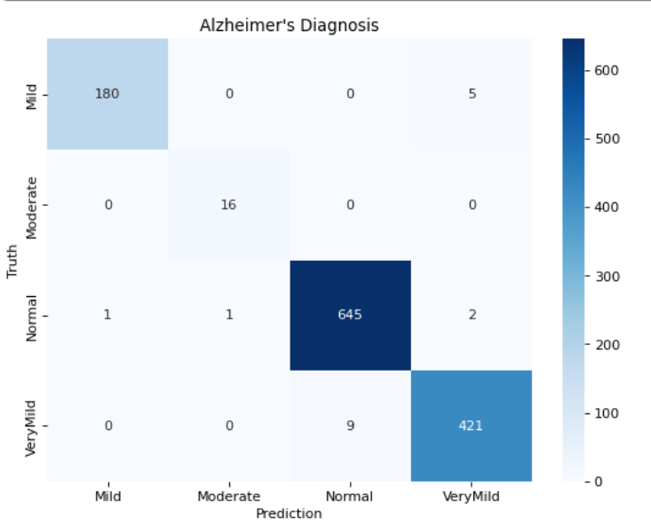
CNN Model
Results:
CONFUSION MATRIX:
This model is better with validation accuracy 97.9% and test accuracy is 98.6% and it is the best accuracy we achieved .

Slide 26
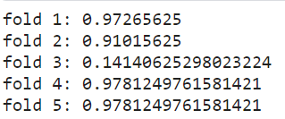
CNN Model
We used K-fold cross validation on this model to enhance the accuracy more using K=5
Test accuracy For each fold:
In fold 3 , the model may not be able to learn the underlying patterns in the data and may get stuck in a local minimum.

Slide 27
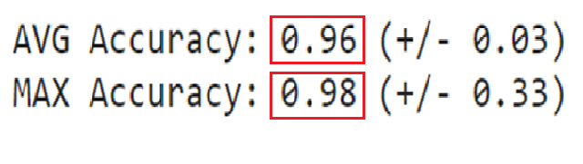
CNN Model
Average and Maximum Test accuracy For folds:
Comment on Results:
The maximum accuracy was the same as the previous model and did not improve. Therefore, we decided to use the previous model for deployment.

Slide 28
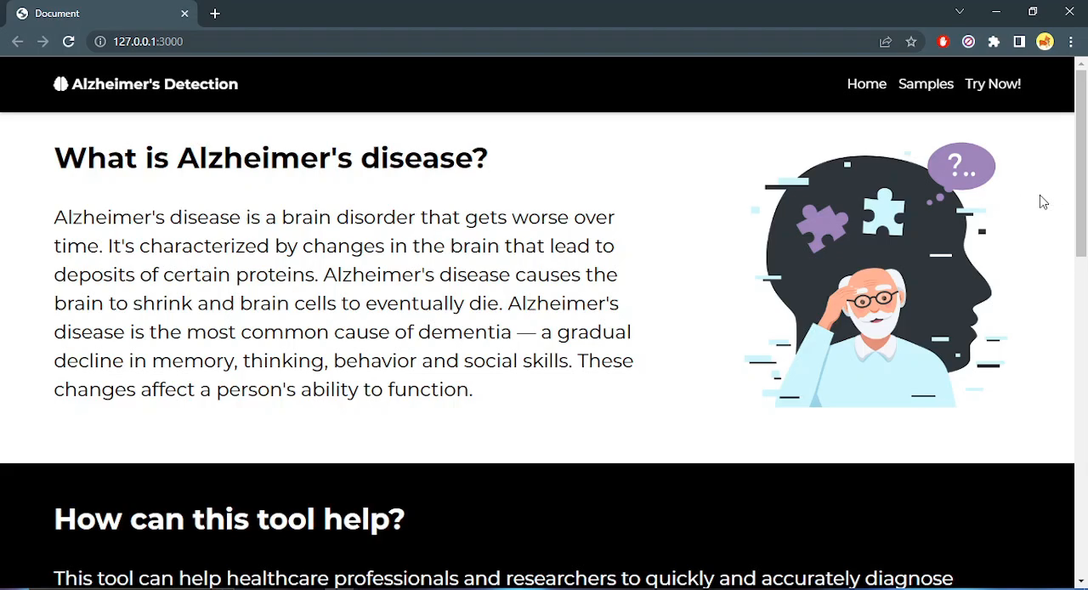
Demo

Slide 29
Future Work
Expanding the data set: Our project used a publicly available MRI dataset, but there are many other datasets available that could be used for Alzheimer's disease classification.
Improving data quality: develop new preprocessing techniques or data augmentation strategies to improve the quality of the MRI data used for Alzheimer's disease classification.
Add more features to our website.

Slide 30
Time Plan
2022
2023
Week 1
5
9
13
17
21
25
29
Oct 25, 2022
Today
Project Approval
Learning the needed background about ML and deep learning
Oct 25 - Nov 10
Making survey related to our project
Nov 11 - Nov 20
Preprocessing on the data
Nov 21 - Dec 10
Construct the model
Dec 11 - Dec 30
Construct the model
Jan 26 - Mar 20
Model enhancements
Mar 21 – May 20
Model Deployment
Mar 21 - May 20
Designing the interface and writing our final documentation
Oct 25 - May 20

Slide 31

Thank you

